Slide 1
What is a Data Management Plan and why do I need one?
Presented by:
Dylanne Dearborn Research Data Management Coordinator, Map and Data Library University of Toronto Libraries
June 2022

Slide 2
Objectives
Describe why planning and managing research data is important
Identify common elements often included in data management plans
Locate resources and supports for developing a data management plan

Slide 3
Agenda
What is Research Data Management (RDM)
What is a Data Management Plan (DMP)
The purpose of a Data Management Plan
What a Data Management Plan covers
How to create a Data Management Plan
Data Management Plan resources

Slide 4
What is Research Data Management

Slide 5
What is Research Data?
What is collected, observed, or created for the purpose of analysis to produce original research results
"Research data" will mean different things for different projects
Includes notes, documentation, scripts, etc.

Slide 6
What is Research Data Management (RDM)?
RDM is about handling research data effectively and appropriately throughout a research project, from beginning to end and beyond
RDM refers to all aspects of planning, creating, processing, storing, sharing and preserving data
RDM is an essential aspect of conducting responsible research
Well managed research data means:
Others should be able to understand your data
Others should be able to reproduce your results

Slide 7
Research Data Management - Planning
Planning means:
Preparing for the research project
Conceptualizing data management actions across project stages
Developing consistent approaches for working with the data
Considering what is needed to carry out the strategy
Documenting and formalizing the strategy = a Data Management Plan (DMP)

Slide 8
What is a Data Management Plan

Slide 9
Definition of Data Management Plans from the Tri-Agency Research Data Management Policy FAQs
“A data management plan (DMP) is a living document, typically associated with an individual research project or program that consists of the practices, processes and strategies that pertain to a set of specified topics related to data management and curation. DMPs should be modified throughout the course of a research project to reflect changes in project design, methods, or other considerations.
DMPs guide researchers in articulating their plans for managing data; they do not necessarily compel researchers to manage data differently.”
Tri-Agency Research Data Management Policy FAQs https://www.ic.gc.ca/eic/site/063.nsf/eng/h_97609.html#4-2

Slide 10
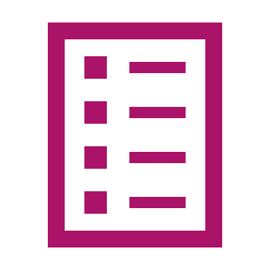
What is a Data Management Plan?
A DMP is simply a short, formal document developed at the start of a research project which outlines the plan for all aspects of data management
Details what you are doing with your data during and after the project

Slide 11
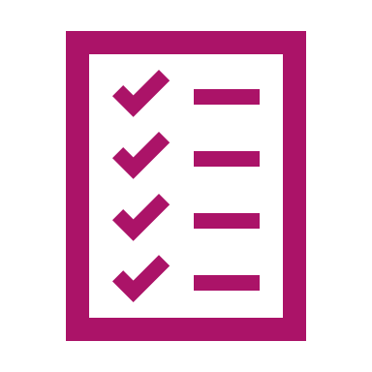
Typical components of a DMP
Administrative details
Data collection
Documentation and metadata
Storage and backup
Retention and preservation
Sharing and reuse
Responsibilities and resources
Ethics and legal compliance

Slide 12
The purpose of a Data Management Plan

Slide 13
How is a DMP beneficial to a project?
Stay organized
Improve research quality
Ensure long term access
Share your work
Fulfill emerging requirements

Slide 14
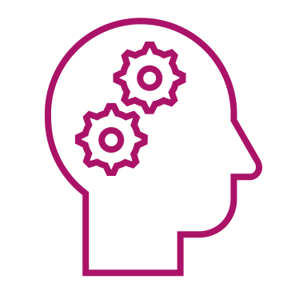
Stay organized
Find your files and keep track of different versions of your data
Helps collaborators be on the same page
Facilitates continuity if project staff leave or new researchers join
Organize and compile information at the end of a project

Slide 15
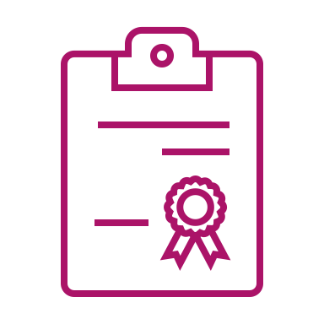
Improve research quality
Ensures necessary supports are in place and included in budget
Helps anticipate and mitigate problems, barriers and risk
Increases project efficiencies, reducing the overall cost and time of research
Increases reproducibility and transparency
Guards against misconduct and data falsification

Slide 16
Maintain long-term access
Helps prepare data packages to retain or deposit into a repository
Enables preservation actions

Slide 17
Share your work
Enable the reuse of your data
Increase visibility and scholarly impact
Encourage collaboration and interdisciplinary research

Slide 18
Fulfill emerging requirements
Satisfy granting agency*, partner, and/or publisher requirements
*Further information: Tri-Agency Research Data Management Policy and DMP update

Slide 19
Effective Data Management Plans
Are detailed and project-specific
Inventory all data needs across the project
Require thought and considerations for all decisions
Bear in mind the wider context and consequences of different options
Have buy-in from all collaborators
Detail who is responsible for certain actions
Include review and evaluation
Are a living document – update as changes to process are needed (a DMP can be versioned)

Slide 20
What a Data Management Plan covers

Slide 21
Typical components of a DMP
Administrative details
Data collection
Documentation and metadata
Storage and backup
Retention and preservation
Sharing and reuse
Responsibilities and resources
Ethics and legal compliance

Slide 22
1 | Administrative details
Provides an overview of the research project, including:
Project details and description
Who is responsible for the project
Who is responsible for the data
Contact information

Slide 23
2 | Data collection
Provides a description of the data, including:
What data you intend to collect, generate or use
The different types of data, formats and programs you will be working with
How you will organize and structure the data

Slide 24
3| Documentation and metadata
Information that allows the data to be understood or reused, including:
What documentation will be needed to understand the data
The metadata standard that will be used to describe the data (if needed)
How you will capture this information throughout the project

Slide 25
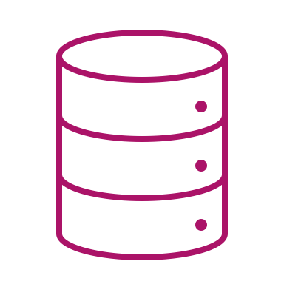
4| Storage and backup
Details the space and procedures for keeping the data during the active phase of research, including:
An estimation of the amount of data being generated
Where the data will be kept (both working and backup)
What security measures are needed
Mechanisms and schedules

Slide 26
5| Retention and preservation
Details what happens to the data at the end of the project, including:
The files, formats, documentation that will be kept
How long will data be kept and what will be discarded
Where will it be kept after the project concludes
How it will remain accessible over time

Slide 27
6| Sharing and reuse
Details about how you will provide access to external parties, including:
Any restrictions or reasons data will not be shared
Strategies to mitigate any issues related to data sharing
What data will be shared
Mechanism for sharing
Conditions of access

Slide 28
7| Responsibilities and resources
Plans the oversight of project provisions, including:
Roles of team members related to data actions
The use of available resources
Budget considerations for personnel or services
Budget for required tools, software or hardware

Slide 29
8| Ethics and legal compliance
Outlines strategies to ensure data will adhere to applicable requirements, including:
Privacy legislation and laws, including funding and institutional requirements
Any legal, ethical, contractual, and intellectual property issues when managing and sharing the data
Actions that need to be taken across a project to ensure compliance
Obligations related to the secure management of sensitive data

Slide 30
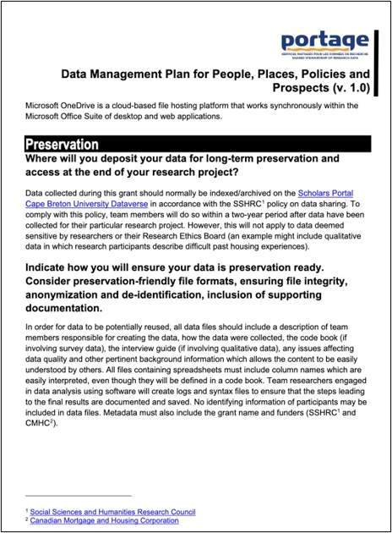
Example pages of a compiled DMP

Slide 31
Considerations for an effective DMP
Time consuming up front, but saves time later
Make it understandable - avoid extended use of acronyms or discipline-specific jargon
Consider all ethical, cultural, legal or IP considerations
Consider using existing supports
Include rationale for decisions
Do not leave relevant sections or questions blank
Include sufficient detail for review and evaluation
Be prepared to implement your plan

Slide 32
How to create a DMP

Slide 33
DMP creation
Short document to state the RDM plans - consider it a living document
Can be point form, paragraph, etc.
There are tools for drafting DMPs:
DMPonline (United Kingdom)
DMPTool (United States)
DMP Assistant (Canada)

Slide 34
What is a DMP template?
A DMP template has a set list of questions that a researcher can use to create a robust plan. Templates can:
Come from a funder or institution
E.g., UK - Arts and Humanities Research Council (AHRC) DMP template; US - National Science Foundation (NSF) Arctic Data Center: Polar Programs DMP template
Be for specific disciplines
E.g., water quality research, art-based research
Be for specific research methods
E.g., systematic reviews, mixed methods (surveys and qualitative research)
Include tailored guidance to assist in addressing important aspects of the question or providing insight into supports available

Slide 35
Data Management Plan resources

Slide 36
DRI Portal and the UTL RDM website
The DRI Portal offers guidance and resources related to data management planning. University of Toronto Libraries (UTL) also offers best practices and resources for DMPs.
https://cris.utoronto.ca/dri_portal/
https://onesearch.library.utoronto.ca/researchdata​

Slide 37
UTL DMP guidance and checklist documents
UTL maintains resources that assist in preparing researchers to address typical DMP topics and questions
UTL DMP - Question Guide
UTL DMP - Planning Checklist

Slide 38
DMP Assistant
DMP Assistant is a national, bilingual tool available to assist researchers in preparing data management plans
Includes templates, guidance and examples
Freely available
Supports cross-institutional research collaborations
Role-based permissions (co-owner, editor, or read only)
Exports to multiple formats
https://assistant.portagenetwork.ca/

Slide 39
The Alliance – DMP Templates
The Digital Research Alliance of Canada offers DMP templates by discipline and research method
https://alliancecan.ca/en/services/research-data-management

Slide 40
The Alliance – DMP Exemplars
The Digital Research Alliance of Canada offers examples of DMPs created for different types of projects
https://alliancecan.ca/en/services/research-data-management

Slide 41
Help with DMPs
Services to support DMP creation and RDM practices are available through the Map and Data Library
General questions
Consultations
Workshops
Instruction sessions
https://library.utoronto.ca/researchdata
email: rdm@utoronto.ca or cris@utoronto.ca

Slide 42
Key Takeaways

Slide 43
Key takeaways
DMPs can be a useful tool to help design an effective research project
There are resources to help you create a DMP
Plan for, and practice, good research data management - it will help your research team to:
Stay organized,
Improve the quality of your research,
Maintain access to your data over time,
Share your data with others, and
Fulfill funding, partner, and publisher requirements

Slide 44
Questions? cris@utoronto.ca or rdm@utoronto.ca

Slide 45
Acknowledgements
Some content modified from:
Dearborn, D., Forbes, S., Umetsubo, Y., Henshilwood, A., Maistrovskaya, M. (2021). Research Data Management Level 2: Data Management Plans. University of Toronto Libraries.
Grenier, M. (2021). Introduction to Data Management Plans. University of Victoria Libraries Digital Scholarship Commons.

