Slide 1
Webinar: Research Governance & Risk Management January 20, 2023 @ 10-11:30 am Eastern
Developed and presented by P Alison Paprica, PhD, PMP Hosted by the Centre for Research & Innovation Support (CRIS)

Slide 2
A Vision with a Plan can Change the World
"A vision without a plan is but a dream, a plan without a vision is drudgery, but a vision with a plan can change the world."
proverb, ~1730
Research naturally, and appropriately, has its focus on the vision – what might be knowable, or possible…
But, there comes a point where some kind of a plan for research is needed
This webinar focuses on three light-touch tools and processes, tailored for research, that help the team create and implement a useful plan for their research so that they can achieve their vision

Slide 3
Webinar Learning Objectives
At the end of the session, participants will be able to:
Understand the difference between governance and management bodies
Match a governance and management structure/ organogram to the size, scope and objectives of a research project or program
Create meeting agendas that support good decision making
Identify common research project risks and possible responses to them

Slide 4
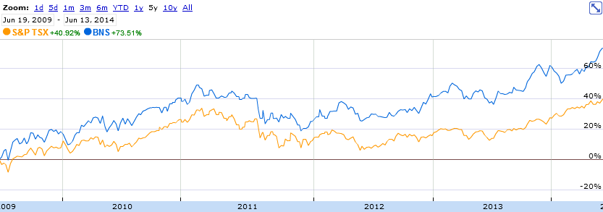
Standard Tools/Processes are Useful
Just as the financial sector has developed tools and processes to make sense of stock price information…
The project management community has developed excellent ways to capture and utilize information about projects
These “project management tools” are useful in themselves AND the processes associated with populating, updating, and using the tools ensure a comprehensive approach

Slide 5
About this Webinar
Elements of this have been delivered to over 1,000 people including:
VP Research and Innovation invitation-only workshop for U of T’s largest grant recipients
Graduate student courses at the Institute for Health Policy, Management and Evaluation
Social Sciences and Humanities Research Council (SSHRC) Partnerships Grant Start-up Meeting
Canadian Institutes for Health Research (CIHR) Health System Impact Fellows training
Natural Sciences and Engineering Research Council (NSERC)-funded “CREATE” programs
“IDEAS” Ontario quality improvement training for hospital teams
U of T School of Continuing studies courses
CRIS/CDRS webinars and workshops
Custom workshops for Canadian Evaluation Society, Cornell University, and many others…
This webinar presents a subset of 35+ hours of existing content using examples intended to show the applicability and generalizability of the light-touch project management approach across disciplines

Slide 6
Tools and Processes Presented Today
Tool or Process | In Webinar Slides | In Handout Slides | Downloadable Template
TOOL: Modifiable governance and management organograms | ✓ | ✓ | ✓
TOOL: Elements of Terms of Reference for committees, Working Groups or Teams |  | ✓
TOOL: Elements of a sample Governance & Management Plan |  | ✓
PROCESS: Two options for decision-making | ✓ | ✓
TOOL: Meeting Agenda template |  | ✓ | ✓
TOOL: Marked-up Meeting Agenda to capture key discussion points, action items and decisions | ✓ | ✓
PROCESS: Identifying, prioritizing, and developing responses for important negative risks | ✓ | ✓
TOOL: Risk Management Plan to capture important negative and positive risks, and responses for them | ✓ | ✓ | ✓

Slide 7
Governance

Slide 8
What Do We Mean by Governance?
Governance means how and by whom decisions will be made for the research project or program
Governance bodies either have
an oversight function – serving as the locus of accountability and strategic direction
or
an advisory function – external advisors with relevant expertise and knowledge that provide objective advice from a distance
Management bodies are the ones who do the work

Slide 9
Regular Project
Large Project
Example Research Project
Governance and
Management Organograms
Sponsor or Steering Committee
Steering Committee or Sponsor
Principal Investigator (PI) or Project Lead
Research Executive Committee (Chaired by PI)
Core Team(s)
Advisory Committee(s)
Principal Investigator (PI) or Project Lead
Core Team (Chaired by PI)
Legend
[Possible Advisory Committee]
Governance
Management

Slide 10
Example Multidisciplinary Program of Research
Governance and Management Organogram
Steering Committee
Principal Investigator (PI)
Research Executive Committee (Chaired by PI)
Research Team 1 Lead
Knowledge Users Advisory Committee
Research Team 2 Lead
Training & Capacity Building Lead
Research Team 3 Lead
Intended Beneficiaries Advisory Cmte

Slide 11
Health Data Research Network Canada Governance And Management Source: HDRN Canada Website

Slide 12
Governance Bodies

Slide 13
The Sponsor
In project management the term “Sponsor” or “Executive Sponsor” are almost universally understood to mean a senior person external to the project who serves as a champion/advocate for the project and, in some cases, is accountable for the project
The Sponsor’s contribution is strategic, NOT day-to-day activities, e.g.,
Help identify and/or secure additional financial or other resources if opportunities or risks mean that the project/program requires additional resources to succeed
Provide advice and/or direction when the project/program lead(s) need assistance making decisions and/or managing risks and opportunities
Support the project politically
Confirm the scope of work and advise on potential changes to scope (e.g., decreasing scope in response to time or budget overruns)
Approve or make decisions that are beyond the capacity/authority of the project team

Slide 14
The Sponsor cont.
Generally, the higher the level of the Sponsor within the organization, the higher the probability of project success because you have someone to go to if escalation is needed
If at all possible, secure a senior person to serve as Sponsor for your project and keep them updated them regularly (not just when there are problems), e.g., Dean, Vice-Dean, Department Head, Professor Emeritus
If the term “Sponsor” has the potential to be confused with “Funder” (e.g., in industry-sponsored research), use some other term that makes sense in your environment, e.g., “Executive Project Advisor” or “Senior External Project Director”

Slide 15
External Governance Bodies
Larger initiatives and programs of research will often have one or more governance bodies
Steering Committees provide direction and in some cases make decisions (usually comprising external experts not directly involved in the project with the PI as an observer, this is different from the “Research Executive Committee” which is chaired by the PI)
Advisory Committees provide advice (they may or may not come to consensus on their advice and the advice should be considered by the team but may or may not be acted on)
Scientific Advisory Committees often include international members
Describe how the committee will function, their responsibilities and contributions in a Terms of Reference document, e.g., specify if/when/how they
Provide advice or direction on topics that the PI or research team brings forward
Provide advice or direction on topics that members think are important, even if the PI and research team haven’t brought them forward for discussion
Provide advice or direction when the PI and team are unable to decide on their own (or do not have the authority to make a decision)

Slide 16
Tool: Terms of Reference (ToR) Document
Background of project/program and purpose of committee
Chair(s) and membership (not who they are, just the composition, e.g., numbers and required/desired diversity) sometimes including information about how members are selected
Scope/Responsibilities
e.g., oversight, advice on risk and opportunity management, financial decisions and decisions that affect scope, others
Authority (what decisions can they make/not make)
Quorum (how many members need to participate for a decision to be valid)
Decision making process
Try for consensus, majority vote if necessary OR try for consensus, escalate if necessary
Certain decisions that can be made by the Chair, or a named subset of members
Commitment to keep a record of decisions and action items (vs. minutes for Boards)
Work commitment/meeting frequency (e.g., 10 hours per year including 4 virtual meetings)
Term (including “full length of project” if that is the expectation)
Appendix with list of named members

Slide 17
Tool: Governance and Management Plan
Year 1
Hire Project Manager (or ED or equivalent) develop planning documents to ensure common understanding of scope, schedule, budget and decision-making process
Monthly or biweekly core team meetings (and possibly Research Executive Team [Exec] meetings) including status updates highlighting key accomplishments, key risks to be managed, upcoming decisions/milestones
Establish governance body(ies) – Steering, Advisory, Scientific and develop Terms of Reference
Once per quarter (~ every third meeting) core team or Exec meeting also includes project team quarterly review of risks, and potentially necessary discussion of changes to scope, schedule or budget
Quarterly updates / advice from governance body(ies) focused on accomplishments, risks and opportunities
Middle years
Monthly or bimonthly core team and Exec meetings including status updates highlighting key accomplishments, key risks to be managed, upcoming decisions/milestones
Twice per year, core team or Exec meeting also includes project team quarterly review of risk management plan, potentially necessary discussion of changes to scope, schedule or budget
Biannual updates / advice from Governance body(ies) focused on accomplishments, risks and opportunities
Final Year
Monthly core team or Exec meetings including status updates highlighting key accomplishments, key risks to be managed, upcoming decisions/milestones, and summary of project impact, and plans for next steps
2-3 sessions with governance body(ies) focused on completing the project, ensuring impact and next steps

Slide 18
Management Bodies and Decision-Making Processes

Slide 19
Potential Tough Decisions
Who gets a decreased budget when unavoidable fixed costs increase, or the budget is cut
A partner organization or researcher needs to leave or be disinvited because they are not making sufficient contributions
Intellectual Property, what % to whom
Authorship assignments
External factors mean the project should terminate (e.g., you’re scooped)
Other ideas - please enter in Chat
All of these decisions are less contentious if you have determined (up front) how and by whom the decisions will be made

Slide 20
Core Team & Research Executive Committee
Core team will Ideally be 7-10 people who do project work daily to biweekly
Project Lead/Principal Investigator
[Project] Coordinator
Deliverable Lead(s)
[Sub-deliverable leads]
People who aren’t the “lead” for anything, but do core project work
Core team meetings are the most frequent, e.g., weekly or biweekly
Large projects may also have a “Research Executive Committee” comprising the PI, co-Is, Project Manager/Director

Slide 21
Research Team Decisions
Broader Project Team decides?
Including people who only come to meetings occasionally or aren’t in touch? What if your project team includes 40+ people and the next meeting isn’t for weeks or months?
Principal Investigator (PI) alone decides?
Lose the benefit that diversity of opinions usually brings to decisions.
Core Team decides?
Do all opinions really have the same weight? Be honest about who makes decisions. Often it is a subset of the Core Team members that actually makes them.
“Research Executive Committee [Exec]” comprising the PI plus a few others decides
Often a practical solution, and sometimes as a practical backup if Core Team cannot come together to meet, and/or can be used for decisions that other team members aren’t in a position to contribute to.
NOTE: NOTHING PREVENTS THE TEAM FROM CONSULTING WITH AND INVOLVING OTHERS IN A DECISION, BUT IT IS GOOD PRACTICE TO ESTABLISH – UP FRONT – WHICH INDIVIDUALS MUST BE INVOLVED FOR A DECISION TO BE VALID

Slide 22
How are Decisions Made – Option 1: Attempt Consensus, Escalate if Necessary
Aim to give notice of an upcoming decision one week before a decision is required (or at least two days)
Strive to make decisions by consensus, i.e., decisions that no member indicates dissent for, noting that abstaining does not count as dissent
If there is not consensus, and where time allows, the member presenting the item is asked to make efforts to modify the item, within a timeframe specified by the Chair, with the goal of making changes that allow consensus to be achieved
If consensus cannot be achieved within the timeframe specified, decisions will be made by higher authority body or individual, e.g., Chair, Executive Sponsor, Steering Committee

Slide 23
How are Decisions Made – Option 2: Attempt Consensus, Vote if Necessary
Aim to give notice of an upcoming decision at least one week before a decision is required
Strive to make decisions by consensus, i.e., decisions that no member indicates dissent for, noting that abstaining does not count as dissent
If there is not consensus, and where time allows, the member presenting the item is asked to make efforts to modify the item, within a timeframe specified by the Chair, with the goal of making changes that allow consensus to be achieved
If consensus cannot be achieved within the timeframe specified by the Chair, decisions are made by majority vote, i.e., the decision will be made if more than 50% of the members contributing to quorum vote to support it (some have the Chair’s vote break ties)
In cases where there is a tie, input will be sought from members who were not present when the vote was taken within a timeframe specified by the Chair
In cases where there is a tie after votes have been counted from all members that are available in the specified timeframe, the higher authority body or individual decides

Slide 24
Meetings and Decision-Making
It’s research, things will NOT go exactly as planned
The questions are, who will decide what to change, and how and when will they do that?
Meetings are the primary mechanism through which the expertise and perspectives of qualified people come together so that informed and strategic decisions can be made
Meeting effectiveness can literally make or break million dollar initiatives
With the increased size and complexity of research and evaluation projects, the need for productive meetings has never been greater

Slide 25
Tips and Tricks for Meetings
Have an agenda that states the objective(s)/purpose
Use most of the precious time that team members are together in real time for active and generative discussion and decisions
Rarely, it is worthwhile to use meeting time for presentations that ensure everyone has a common understanding of a topic, issue, or opportunity (but usually this information can be shared FYI as attachments)
Identify a strong Chair who will ensure:
The objective(s)/purpose are met
Good process is followed and there is an opportunity for all participants to contribute their knowledge and perspectives
Challenging attendees are managed
There is clarity about what was decided and who is responsible for which action items

Slide 26
Tips and Tricks for Meetings cont.
Send materials at least two business days in advance of the meeting (one week is even better)
For internal meetings (e.g., Core Team, Research Executive Committee) NEVER spend valuable meeting time reading bullet points on slides
People can and will read faster than you can speak
They will tune out and do other things if you attempt this (with web meetings it can be hard to know)
If you do present something, provide complementary remarks as opposed to reading bullets
Exceptions may be informational presentations to Steering Committee or External Stakeholders (but even then, try to paraphrase vs. read bullet points on a slide)
The whole point of meetings is that people come together to discuss and do thing synchronously that cannot be done independently
For decision items summarize key facts and considerations in the agenda, and attach more detailed documents for those who want to read them

Slide 27
Tips and Tricks for Meetings cont.
Avoid roundtable updates
Consider FYI items submitted in advance instead
Avoid lengthy roundtable introductions
Consider having people submit bios and state their ‘hopes’ at the first (kick-off) meeting
If a few people start talking about a particular topic, do let the 2-3 person discussion proceed in they can immediately decide on a course of action, but ask them to take it offline if it is taking more than a few minutes
Have some fun, otherwise people won’t want to come to your meetings anymore
Facilitation techniques are useful, particularly when you have diverse participants

Slide 28
Tool: Meeting Agenda

Slide 29
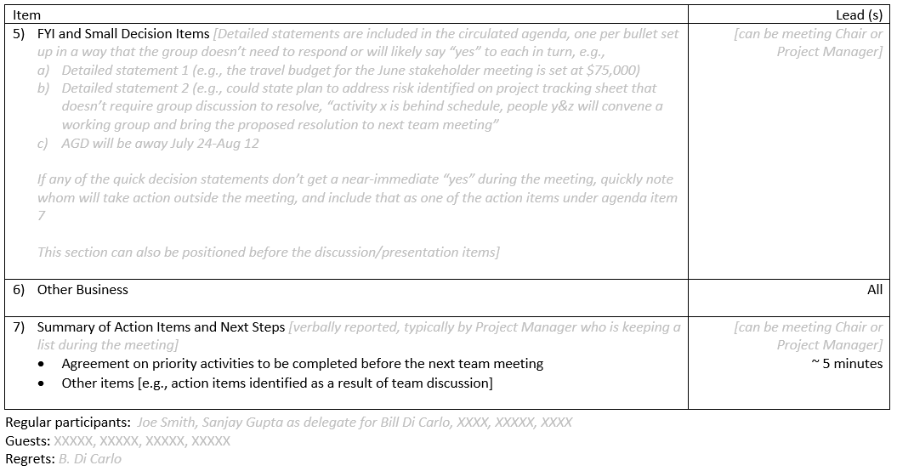

Slide 30
Ending Your Meeting
It’s good practice to have “Other Business” to allow for new items if there is time
After Other Business, the Chair or the project manager should recap the list of decision and action items from the meeting, inviting others to add to the list if they have missed anything
Consider whether there is any value in having minutes prepared, often a marked up agenda with only essential notes and action items will be less time consuming to prepare, and a more effective way to communicate (particularly if that information is transferred to the tracking sheet discussed in webinar 1)

Slide 31
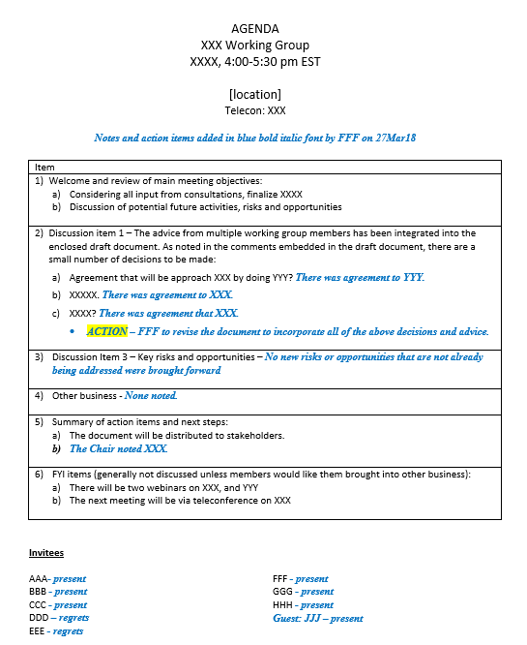
Tool: Marked-Up Meeting Agenda to capture Decisions and Action Items
Notes and Action Items can even be added in real time on a shared screen
This can help ensure that everyone leaves the meeting with the same understanding of the work to be done and who will do it

Slide 32
Closing Thoughts on Decision-Making Meetings
People at your meetings have other things going on in their lives
Having well-organized meetings with specific objectives and good agendas, can help increase engagement, but there will still be distractions and threats to meeting success
If it is a really important decision, leave as little to chance as possible, you will need a strong Chair, complete background materials, and good process
Ensuring that decisions are informed, and get the attention they require, is a form of leadership

Slide 33
Risk Management

Slide 34
Always Be Prepared

Slide 35
Project Risks
A risk is an uncertain event or condition that, if it occurs, would have a positive or negative effect on one or more project objectives
If you KNOW IT WILL occur or it HAS occurred, it isn’t a risk, it’s an issue (negative risk realized) or an opportunity (positive risk realized)
Risk Management is mostly about up-front thinking and low resource activities to decrease the likelihood of important negative risks occurring and/or the impacts if negative risks are realized
It is also a good idea to give some thought about how to increase the chances you’ll realize benefits from positive risks

Slide 36
Process: Group Negative Risk Identification for Teams
Individuals take a few minutes to make a list of important negative risks for the project. It may help to think in terms of “If X happens, it would be bad”, “X” being the negative risk.
Form small groups and use polling (or sticky notes) to have the small groups identify 5-7 individual negative risks (one at a time) that are considered to be important considering both:
likelihood (chances of it happening)
impact (effect if it does happen)
Discuss the negative risks identified in breakout groups to make sure everyone has a common understanding of what each suggested risk means (possibly merging similar risks)
Through a combination of discussion and/or voting come to consensus about the top cluster of risks (usually 3-7) that warrant the development of risk responses

Slide 37
Risk Voting
In the workshop version of this content, people brainstorm and prioritize their own risks
For the webinar, we’ll ask people to pick their top five negative risks from a list generated based on previous sessions considering both:
likelihood (chances of it happening)
impact (effect if it does happen)
Voting is at www.pollev.com\pm4r (each person gets five votes, and you can skip registration if prompted)

Slide 39
Top Negative Risks from Other Workshops
In 15 risk management workshops performed with academic research team members
Eight groups voted one or more risks related to funding into their short list of top negative risks
Usually risk of budget cuts, or the risk that funders would withdraw
Two groups identified the risk that grant funding would not be approved or renewed
One group identified delays in funding as a negative risk
Eight groups voted the risk that a team member would leave or be unavailable as one of their top negative risks
In some cases, participants focused on the risk that a team would become short-staffed if a staff person were hired away
Also concern that the Principal Investigator or a research staff person would leave the project (temporarily or permanently) or become ill, or die
Others referred to general issues with turnover
Source: Paprica PA. Risks for Academic Research Projects, An Empirical Study of Perceived Negative Risks and Possible Responses. arXiv preprint 2022 Mar 14. https://arxiv.org/abs/2103.08048

Slide 40
Negative Risks Responses
For the negative risks with the most votes, develop risk responses:
Avoid – change the plan to take the risk out of the picture
Mitigate – adjust the plan to decrease likelihood of the risk occurring and/or the impact if the risk is realized
Transfer – shift the risk to a third party (e.g., insurance)
Accept – acknowledge the risk but invest no resources in a risk response for it
Notes:
Active or passive acceptance, active being contingency funds available

Slide 41
high
Risks that you may avoid or transfer
Risks that you may establish
mitigation strategies for
LIKELIHOOD
Risks that you may
accept
low
low
NEGATIVE IMPACT
high

Slide 42
Possible Responses to Risk that Team member will Leave the Project
Mitigate impact: If someone is leaving, reserve the last two weeks for them to transfer their knowledge and documents to other team members vs. having them do project work until the very last hour
Mitigate likelihood: Offer a flexible work environment that makes it less likely people will leave for another job
Accept: Understand that people who are just starting out their careers often move every 2-3 years, expect some people to leave the team during the project

Slide 43
Risk Response Variation
high
high
Avoid/ Transfer
Mitigate
Avoid/ Transfer
LIKELIHOOD
Accept
LIKELIHOOD
Mitigate
Accept
low
low
low
high
low
high
NEGATIVE IMPACT
NEGATIVE IMPACT
Risk responses will depend on risk tolerance
Also impacted by resource availability (financial and human)
Transfer and mitigation consume resources and projects don’t exist to manage risks, they exist to produce things

Slide 44
Positive Risks (Simplified)
Compile a list of positive risks (a.k.a. potential opportunities)
Assess the likelihood and impact of each positive risk
For the top positive risks consider responses:
Exploit – take measures to ensure that the opportunity is realized
Enhance – change/adjust the plan to increase likelihood or impact
Share – partner with others to enable realization of benefits
Accept – don’t actively pursue (but possibly act on it if it “knocks”)

Slide 45
Examples of Positive Risk & Possible Responses
Exploit – take measures to ensure that an opportunity is realized, e.g.,
You are told that you can receive an additional $60K if you complete a particular milestone 6 months earlier than planned; you change the project plan so that the milestone is completed earlier ensuring you will receive the additional funds
Enhance – change/adjust the plan to increase likelihood or impact, e.g.,
You hear that a funder may (or may not) have surplus year-end funds available, you create a list of new deliverables that the funds could be invested in and share it with the funder to increase the likelihood they will invest surplus funds in your project
Maintain a short list of enhancements or new activities you will invest in if a large piece of equipment is procured for a lower amount than was planned for
Share – partner with others to enable realization of benefits, e.g.,
You have submitted two $1M grant applications with similar scope to two different funders; you don’t have the capacity (team, materials, space) to perform $2M of research if both applications are selected for funding so you reach out to another lab to see if they would be interested in partnering if both applications are successful so that you can utilize the $2M funding if both grants are awarded

Slide 46
“Risk Tornado”
Some risks can have both negative and positive impacts
For example, an external group publishes a systematic review that overlaps with the scope of a literature review that you were planning
There is no forced choice – a single risk can have negative and positive impacts
Negative Impact
Positive Impact
Risk 1
Risk 2
Risk 3

Slide 47
Tool: 1-2 Page Risk Management Plan
Table with top negative risks and the likelihood, impact and risk response for each
Bullet points with key positive risks and responses
Information about when and by whom the Risk Management Plan was developed
Commitment as to when risks will be revisited (e.g., quarterly in first and final years of major initiative, otherwise every 6 months)
[Possible Risk Registry Appendix, i.e., all the negative risks you brainstormed including those that weren’t voted into the top]

Slide 48
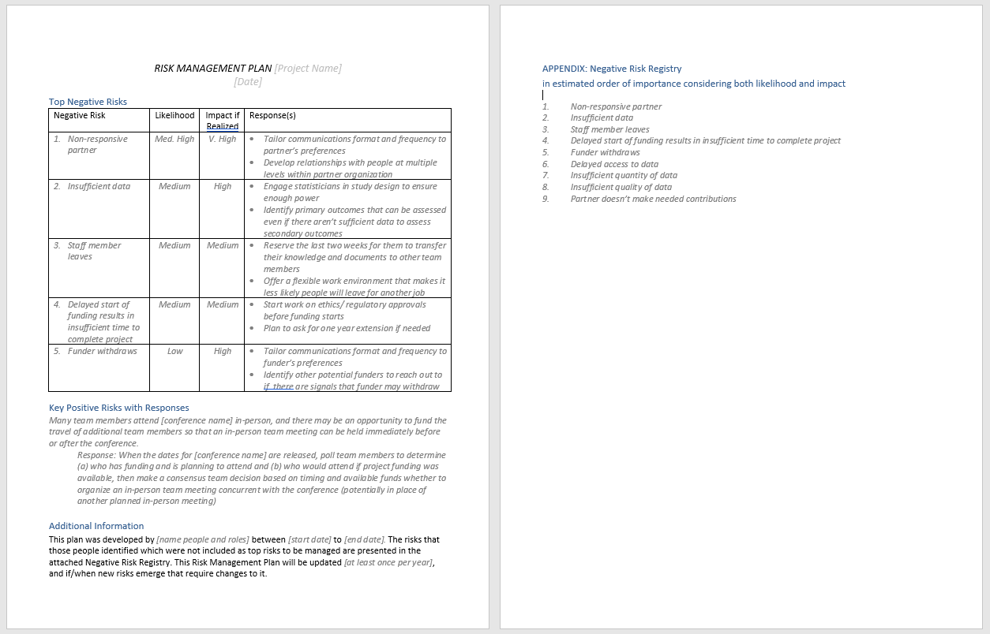
Tool: 1-2 Page Risk Management Plan

Slide 49
Bringing it all Together

Slide 50
Timing for Governance and Risk Management
Applications/proposals may or may not require governance and/or risk management
Even if the topics were part of the application/proposal, things may have changed
For a good transition from planning to implementation:
Confirm the governance body(ies) and their roles, recruit members, and assign resources to support the governance body(ies) contributions
Create/update a risk management plan based on the current context
Circulate and get agreement for the decision-making processes and authorities
It’s research, things will NOT go exactly as planned; good governance and risk management help the team adapt and make good decisions in response to changes

Slide 51
20,000 Foot View of Planning Tools
}
Incredibly Useful
WBS (with deliverable leads identified by the time you are in implementation)
Deliverable-based Gantt chart
Tracking Sheet
Usually Worth Adding
RACI
Deliverable-based budget with break down by funder categories
Status updates
Risk management plan
Helpful in Most Cases
Terms of Reference (TORs) for committees and governance bodies (including documented decision-making authorities/processes)
Stakeholder engagement plan and related documents (e.g., policy/practice briefs)
Communications (beyond status updates and regular review of risks, e.g., meeting agendas)
10Jan23 webinar

Slide 52
If You Want More Light-touch Project Management Tools and Capacity Building
Review the recording of the January 10, 2023 Project Management for Research Webinar under the “Video Library” on the CRIS website
Subscribe to or follow Centre for Research & Innovation Support (CRIS) to learn about additional project management training and capacity building opportunities
Stay tuned for Academic Research Project Management & Leadership: A Handbook for Everyone, to be published by Paprica with U of T press in spring 2023

Slide 53
Recap: Webinar Learning Objectives
At the end of the session, participants will be able to:
Understand the difference between governance and management bodies
Match a governance and management structure/ organogram to the size, scope and objectives of a research project or program
Create meeting agendas that support good decision making
Identify common research project risks and possible responses to them

Slide 54
Q&A and Dialogue

