Slide 1
Webinar Project Management for Research January 10, 2023 @ 1-2:30 pm Eastern
Developed and presented by P Alison Paprica, PhD, PMP Hosted by the Centre for Research & Innovation Support (CRIS)

Slide 2
A Vision with a Plan can Change the World
"A vision without a plan is but a dream, a plan without a vision is drudgery, but a vision with a plan can change the world."
proverb, ~1730
Research naturally, and appropriately, has its focus on the vision – what might be knowable, or possible…
But, there comes a point where some kind of a plan for research is needed
This webinar focuses on three light-touch tools and processes, tailored for research, that help the team create and implement a useful plan for their research so that they can achieve their vision

Slide 3
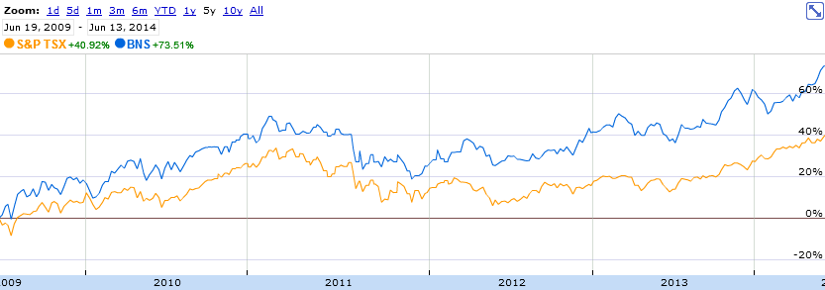
Standard Tools/Processes are Useful
Just as the financial sector has developed tools and processes to make sense of stock price information…
The project management community has developed excellent ways to capture and utilize information about projects
These “project management tools” are useful in themselves AND the processes associated with populating, updating, and using the tools ensure a comprehensive approach

Slide 4
Webinar Learning Objectives
By the end of the webinar, participants will be able to:
Understand how tailored project management tools can be applied to research projects;
Use a work breakdown structure (WBS) to visually present 100% of the scope of a project in terms of deliverables;
Use the deliverables of the WBS to create a Gantt chart schedule; and
Capture project progress information using a deliverable-based tracking sheet.

Slide 5
Projects and the Project Management Mindset

Slide 6
Defining Projects vs. Operations
Projects are temporary endeavors undertaken to create a unique product, services or result
Every project has a beginning and end and produces something unique
Even if your project is very similar to previous projects, small differences in the deliverables or context mean that each project plan also must be unique
Operations are ongoing and may be repetitive
For example, making solar panels at a factory is an example of operations
Because operations are about doing the same thing over and over again, approaches like continuous quality improvement (CQI) and lean six sigma may be used to optimize/perfect how you do them

Slide 7
Project ( ) or Operations ( )?
Buying and installing a new sensor system
Supporting a community of scientists in using data from the sensor
Monitoring toxins in beach water
Campaign to clean local beaches
Creating a new website
Populating a website with new content biweekly

Slide 8
Project Management
Project Management: the application of knowledge, skills, tools and techniques to project activities to meet the project requirements
Mature discipline practiced in virtually every country the world
Tens of thousands of available Project Manager jobs at any point in time
Over one million certified Project Management Professionals (PMPs)
Millions of practitioners linked through comprehensive resources such as the “Guide to the Project Management Body of Knowledge” (PMBOK® Guide) and “Managing Successful Projects with PRINCE2®”
Widely adopted in most knowledge worker sectors, e.g., pharmaceutical, finance, IT…
Often not utilized, or only informally or partially applied in research projects…

Slide 9
Possible Reasons why Project Management isn’t Widely Used in Research
Principle investigator (PI)/ Project Lead is more interested in scholarly outputs and knowledge generation than how the project gets done
Person serving as Project Director/Manager/Coordinator may not have authority and/or knowledge to provide strategic leadership and direction
Higher Education Research “sector” consists of tens of thousands of individual projects that are all led and managed independently
Concern that project management will stifle innovation and creativity
Project management tools, templates, and processes that work very well in other sectors are not directly applicable

Slide 10
Continuum of Project Certainty†
Business Experimental Development or Applied Research
Academic or Government Applied Research & Evaluation
Academic Investigator-driven Basic Research
Non-research Projects
Business Basic Sciences Research
Not-for-Profit
R&D and Evaluation
Most Certain
Least Certain
† with exceptions, of course

Slide 11
Tailoring Project Management for Research and Evaluation
Generally the greater the inherent uncertainty, the fewer the number of pages of planning and management documents
High uncertainty → very short overarching plan (as few as 3 pages)
There will often be more details somewhere, e.g.,
In regulatory submission, permit application, protocols, or research ethics board or IRB submissions
Held by individuals
Within working groups within the project team
In reports to funders
But the overarching plan can be very short because it contains only the essential high-level information that all the team members and stakeholders need to know and agree on in order to work together to complete the project

Slide 12
Project Management Mindset for Research Projects
DEFINE – before you start the activities of the project, work with the team and stakeholders to establish a common understanding of the tangible things (a.k.a. deliverables) that will be produced by the research
then DELIVER – assign qualified deliverable Leads who work together, using their judgement and expertise, to produce the deliverables and complete the project

Slide 13
Deliverable-Orienting Thought Exercise
Imagine a project that you are working on or have worked on
Think about the tangible things (aka deliverables) that are produced by the project
It may help to think of a USB stick or folder with all the documents plus photos of those things that aren’t documents
Think of the “nouns” of the project (the output of the “verbs” of your project)
Include final products (e.g., report, book, articles, physical creations)
And interim products (e.g., terms of reference for a committee, interview guide, meeting agendas, draft blueprints)

Slide 14
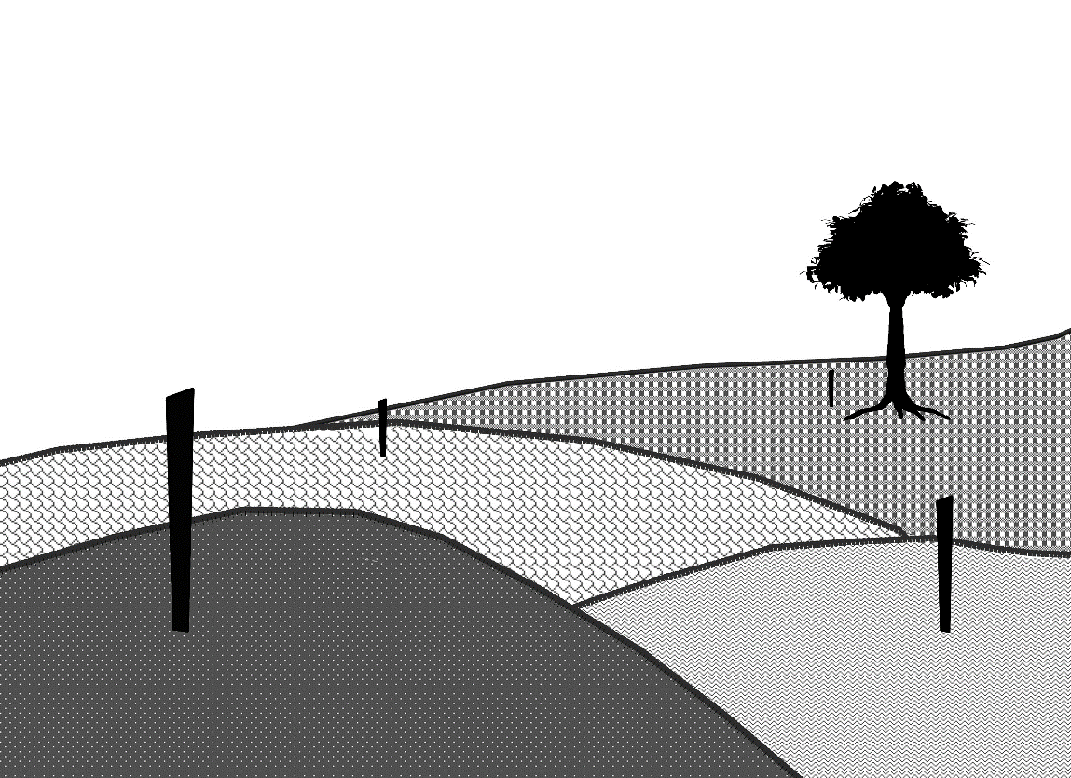
Deliverables as Stakes in the Ground
If, instead of thinking and planning in terms of activities,
you think and plan in terms of the deliverables that those activities will produce,
you will establish a common understanding of what the project will produce
and increase the likelihood of project success

Slide 15
Scope and the Work Breakdown Structure

Slide 16
Project Scope
Scope is the work required to complete a project
Defining scope is often a strength of researchers and evaluators, but
May focus on describing methods and activities rather than deliverables (reviewers scrutinize these)
Often not be benefiting from project management tools and processes that assist in defining/managing complete scope

Slide 17
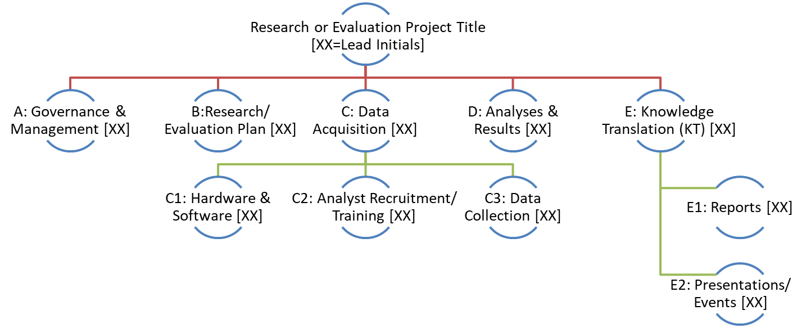
Tool: Work Breakdown Structure
A Work Breakdown Structure (WBS) establishes a common and complete understanding of project scope
For research and evaluation projects:
Like an “org” structure for the deliverables of your project
Think “nouns” not “verbs”
Break work down to the point that there is a common understand of “WHAT” will be produced (leave “HOW” to the deliverable leads)
Include deliverables covering all the scope (not just the core “study”)
See Chat for link with downloadable templates

Slide 18
Example WBS for a Generic Research Project
Research Project
A: Governance & Management
B: Research Plan/Protocol
C: Data/Inputs
D: Analyses & Results
E: Knowledge to Action (KT/KM)

Slide 19
Example WBS for a Generic Research Project
Research Project
A: Governance & Management
B: Research Plan/Protocol
C: Data/Inputs
D: Analyses & Results
E: Knowledge to Action (KT/KM)
B1: Aim(s)/ Question(s)
B2: Method
B3: Approved Full Plan

Slide 20
Example WBS for a Generic Research Project
Research Project
A: Governance & Management
B: Research Plan/Protocol
C: Data/Inputs
D: Analyses & Results
E: Knowledge to Action (KT/KM)
B1: Aim(s)/ Question(s)
C1: Collection Process/ Instruments
B2: Method
C2: Raw Data
B3: Approved Full Plan
C2: Cleaned Data

Slide 21
Example WBS for a Generic Research Project
Research Project
A: Governance & Management
B: Research Plan/Protocol
C: Data/Inputs
C1: Collection Process/ Instruments
C2: Raw Data
C2: Cleaned Data
D: Analyses & Results
E: Knowledge to Action (KT/KM)
E1: Mtgs w Knowledge Users
E3: Other KT/KM Deliverables
B1: Aim(s)/ Question(s)
B2: Method
B3: Approved Full Plan
E2: Publications

Slide 22
Example WBS for a Generic Research Project
Research Project
A: Governance & Management
B: Research Plan/Protocol
C: Data/Inputs
C1: Collection Process/ Instruments
C2: Raw Data
C2: Cleaned Data
D: Analyses & Results
E: Knowledge to Action (KT/KM)
E1: Mtgs w Knowledge Users
E3: Other KT/KM Deliverables
B1: Aim(s)/ Question(s)
B2: Method
B3: Approved Full Plan
E2: Publications
A2: Core Team Meetings
A3: Reports to Funders
A1: Project Governance Committee

Slide 23
Example WBS for a Generic Research Project
Research Project
A: Governance & Management
A1: Project Governance Committee
A2: Core Team Meetings
A3: Reports to Funders
B: Research Plan/Protocol
B1: Aim(s)/ Question(s)
B2: Method
B3: Approved Full Plan
C: Data
C1: Collection Process/ Instruments
C2: Raw Data
C2: Cleaned Data
D: Analyses & Results
E: Knowledge to Action (KT/KM)
E1: Mtgs w Knowledge Users
E2: Publications
E3: Other KT/KM Deliverables
F: Training & Capacity Building
F1: Mentoring Program
F2: Journal Club
F3: Women Scientists Community of Practice

Slide 24
Example 1: Plan Do Study Act (PDSA) Improvement Project WBS
Improvement Project Name
A: Management & Coordination
A1: Core Team Meetings
A3: Monthly Progress Reports
B: PDSA Iterations
B1: Plan for 1st Change
B2: PDSA Iterations
B3: Analyzed Outcomes
C: Implemented Improved Process
C2: Lessons Learned
C1: Process Document for Stakeholders
C3: Plan for Implementation
A2: Driver Diagram
B4: Documented Final Process

Slide 25
A: Governance & Management
A2: Core Team Meetings
A3: Clinical Site Meetings
B: Research Plan/Protocol
B1: Priorities/ Question(s)
B2: Canadian CTA dossier
B3: Health Canada & other Approvals
C: Data
C1: Data Management System
C2: Recruitment
C3: Data
D: Analyses & Results
E: Knowledge Transfer (KT)
E1: Mtgs w Knowledge Users
E2: Publication
E3: Other KT TBD
A4: Progress Reports
Generic Clinical Trial
A1: Steering Committee Meetings
Example 2: WBS for a Generic Clinical Trial

Slide 26
Example WBS for New Investigator Research Program
New Research Program
A: Strategic Coordination
A2: Team Google Drive
A3: Applications for Funding
A1: Team Meetings
A5: Reports to Stakeholders & Funders
B: Research Program/ Theme 1
B1: [Research Project Name]
C: Research Program/ Theme 2
B2: [Research Project Name]
B3: [Research Project Name]
C1: [Research Project Name]
C2: [Research Project Name]
D: Research Program/ Theme 3
D1: [Research Project Name]
D2: [Research Project Name]
D3: [Research Project Name]
A4: International Collaborations

Slide 27
WBS – DO’s and DON’Ts
DON’T have just one thing under a deliverable (if there is only one thing, that IS the deliverable)
DO feel free to have “Other TBD” as a deliverable when you know more deliverables will be produced, but aren’t sure what they will be
DO use the document to establish a common understanding of scope and provide clarification about deliverables that might reasonably be considered in or out of scope
DO use the WBS to check for completeness
Circulate to team then stakeholders and ask the questions “If we produce this – and only this – will the project be complete?” and “Is it clear to you what the words on the WBS mean?”
DO identify leads for deliverables, or at least define deliverables in the way that a Lead could exist
DON’T go into a level of detail that only the subset of the people leading or working on a deliverable need to know about
DO use previously completed WBSs for related projects as a starting point for new WBSs
DO use the WBS as the foundation for all other planning and implementation (e.g., schedule, budget, risk)

Slide 28
The Deliverable-based Gantt Chart Schedule

Slide 29
Project Schedule
The schedule is a visual sequenced presentation of the work required to complete the project
For research projects, focus on dependencies, the amount of time required between the start and completion of each deliverable, and on ensuring ample time to complete all the scope of the project with sufficient quality

Slide 30
Scheduling Objectives
Don’t run out of time
a good amount of the quality of your final product is directly related to how much time you have to review and improve it in the final stages
Don’t forget important work – the schedule must be complete
Understand, at a high level, dependencies
Know which activities are time-constrained
Know which activities aren’t time-constrained – these are a major source of flexibility
Facilitate collaboration and coordination between contributors

Slide 31
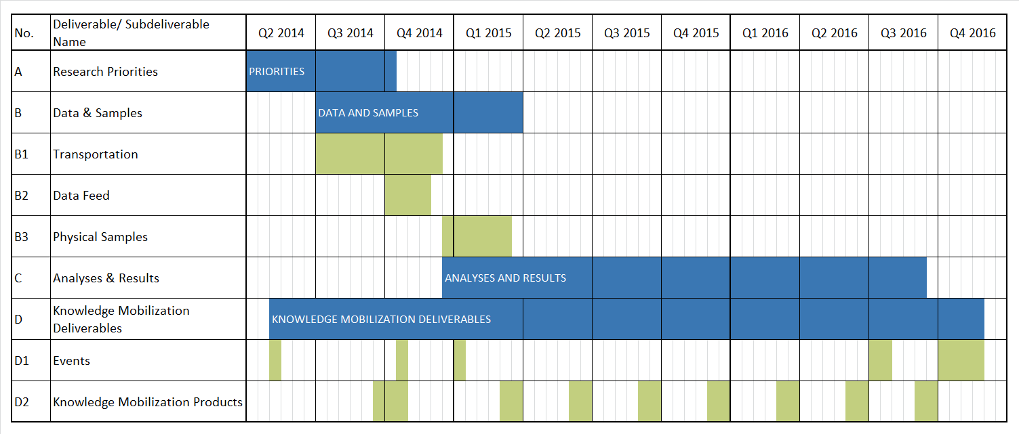
Tool: Deliverable-Based Schedule
Rather than scheduling a list of activities [which may or may not cover 100% of scope], plot the deliverables from your WBS [which constitute complete scope] on the vertical access of your Gantt chart
See Chat for link with downloadable templates

Slide 32
Tool: Developing the Deliverable-based Gantt Chart Schedule
Start with the deliverables from the WBS vs. other words (demonstration)
Beginning with the last deliverable and the project end date, establish the schedule working backwards honouring dependencies and hard constraints
whenever possible, build in buffer at the end (this can make a big difference to the quality of deliverables)
Adjust until you have a schedule that completes the deliverables in the allowed time with no major resource bottlenecks
Add key milestones and/or footnotes that you want to draw attention to (more on that topic to follow)

Slide 33
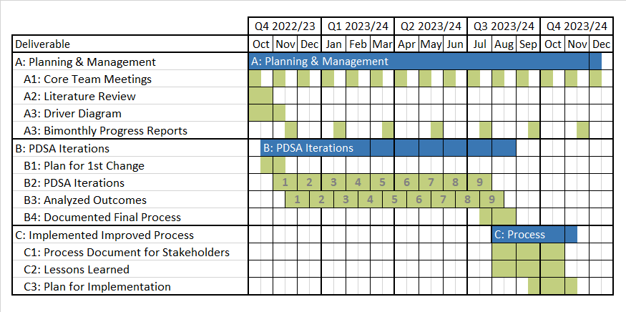
Example 1: Generic Plan Do Study Act (PDSA) Improvement Project Deliverable-based Gantt Schedule

Slide 34
Adjusting the Schedule
Sacrifice preferred logic (fast-tracking) [almost all projects do this]
Perform activities in parallel that are preferably performed in sequence
Start some activities before end of predecessor
Add resources (crashing)
Add new people to complete a deliverable in less time (may not be practical if skill set is rare)
Consume more of the time of existing skilled team members (assuming they have capacity to take on additional work)
Revisit/reconsider “make, buy, partner” decisions for deliverables
Instead of having students and staff make/create a deliverable (e.g., an app, website, or data capture instrument/code built from scratch), it may be possible to condense your schedule in major ways by using commercial products or partnering with a more experienced group/organization who does the work
This will always cost something (money, standard vs. desired features, less control), but may be worth it or necessary to complete the project in the time available

Slide 35
Example 1: Generic Plan Do Study Act (PDSA) Improvement Project Deliverable-based Gantt Schedule

Slide 36
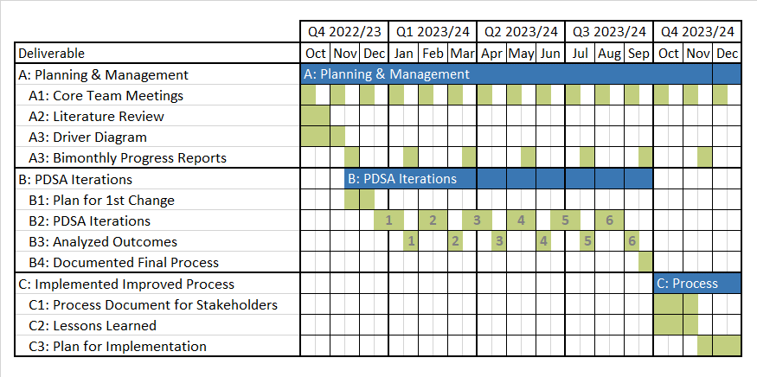
Example 1: RISKY Generic Plan Do Study Act (PDSA) Improvement Project Deliverable-based Gantt Schedule

Slide 37
Example 1: Generic Plan Do Study Act (PDSA) Improvement Project Deliverable-based Gantt Schedule

Slide 38
Milestones and other Schedule Additions
A task of zero duration that shows an important achievement in a project at a specific point in time
Often represented by symbols, e.g., 
Common milestones for projects
MOU signed
First funds received
Research/evaluation priorities/questions agreed upon
Data collection starts
Data collection finishes
Final report delivered
You can also add footnotes to bring a more detailed information into your deliverable-based schedule

Slide 39
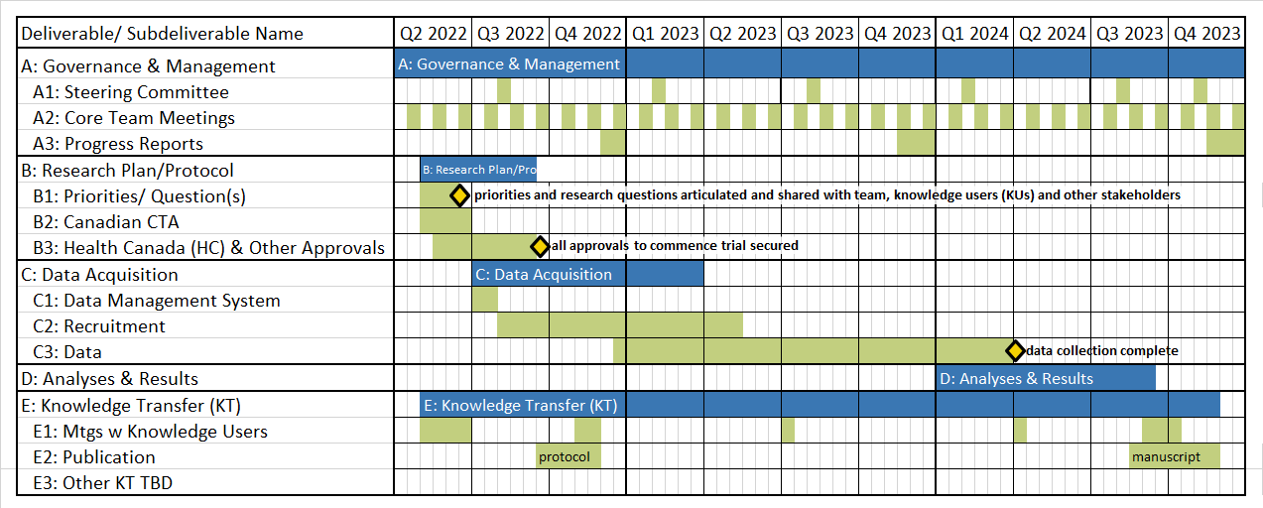
Example 2: Generic Clinical Trial Deliverable-based Gantt Schedule
B2, the Canadian Clinical Trials Application, consists of the following subdeliverables: B2a: Administrative form , B2b: Protocol , B2c: HC protocol summary, B2d: Informed Consent Form, B2e: Investigator’s Brochure​, B2f: Quality Dossier Summary (HC phase-specific template)

Slide 40
Practical Tips
Using shading in MS Excel (vs. MS Project or other project management software has some advantages)
You can cut and paste the deliverables from your WBS in MS PowerPoint into MS Excel
The best unit of planning for research is often half-months (using weeks can cause problems), you can do that with MS Excel but not most other scheduling software (Team Gantt is an exception)
Everyone on the team can view and edit documents created in MS Excel
Incorrect use of MS Project can yield misleading information about the critical path
For most projects, “plan on changing the plan” – don’t make your schedule so detailed that keeping it current takes away from other project work

Slide 41
Post-Project Activities
The impact of your project likely won’t be fully realized until well after the project end date
Plan for follow-up months after the project ends with stakeholders to
Find out what the impact has been
Provide advice if implementation is stalled/impact is not being realized
Possibly obtain advice/input to inform new projects
Tip – Snooze emails or drag/paste them to create a “0 minute” appointments in your email calendar so you’ll be reminded to check in several months in the future – don’t allow yourself to delete them until they are completed or until you have decided not to follow up

Slide 42
Tools for Project Implementation

Slide 43
Tool: Lead Initials on the WBS
It is good practice to identify one Lead for each deliverable on the WBS
Having more than one person as the Lead increases the risk of duplication of effort OR having something slip through the cracks (“I thought you were doing that…”)
Usually, the Lead is the most senior person on the Core Team directly involved with producing the deliverable and/or the person on the core team who has day-to-day decision-making authority for that deliverable (e.g., the person who would speak to the funder if the funder had questions)
The Lead is NOT always the Principal Investigator or another very senior person with overall accountability for the project
Breaking deliverables down and assigning Leads to specific smaller scope “subdeliverables” can be a good way to provide less experienced team members with genuine leadership experience
Lead initials on the WBS is one simple form of a Responsibility Assignment Matrix
Of course, there are roles other than deliverable “Lead” which are very important
The RACI (not presented today) is a very useful for describing other roles and contributions

Slide 44
WBS for Research Study/Trial with Deliverable/Workstream Leads’ Initials
A: Governance & Management (AGD)
A2: Core Team Meetings (KJH)
A3: Status Reports (KJH)
B: Research Plan (AGD)
B1: Research Question(s) (AGD)
B2: Intervention & Study Plan (AGD)
B3: Regulatory & Other Approvals (SU)
C: Study Implementation (SU)
C1: Data Management System (PAP)
C2: Recruitment (SU)
C3: Collected Data (SU)
D: Analyses & Results (SU)
E: Knowledge Translation (PAP)
E1: Mtgs w Knowledge Users (PAP)
E2: Publications (Leads TBD)
E3: Summit (PAP)
Research Study/Trial (AGD)
A1: Steering Committee Meetings (KJH)

Slide 45
Tool: Deliverable-based Tracking Sheet
The Tracking Sheet in Microsoft Excel format is a detailed working document that drives progress in the context of the WBS and Schedule
Every 1-2 months or quarter, a new worksheet “tab” is populated in the Tracking Sheet file to provide a snapshot of project progress and near-term planning
Each tab presents the active work of the project in deliverable rows
Colouring and font effects are used to show all changes relative to the last update
This means that everyone can see at a glance which deliverables are progressing, and which are not
The tracking sheet is not just focused on the immediate next task/activity/milestone to be done, it brings the next group of tasks, activities and milestones onto the radar

Slide 46
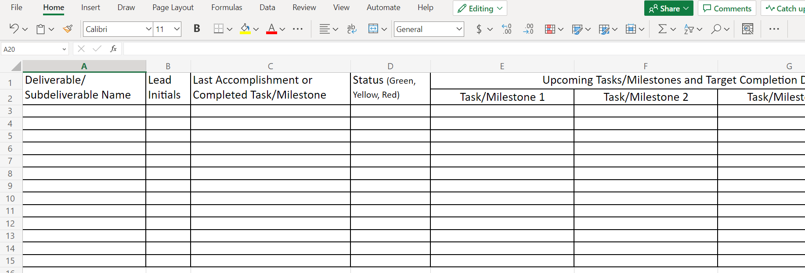
See Chat for link with downloadable templates
The Tracking Sheet
Green: progressing well and within schedule/budget constraints, issues and negative risks (if any) are minor and likely to be resolved without affecting other deliverables
Yellow: low impact negative risks have been realized and/or medium or high impact negative risks have potential to be realized in the near future that could necessitate changes for deliverable and/or planning
Red: progress halted, significant decisions and/or activities required to bring workstream back on track

Slide 47
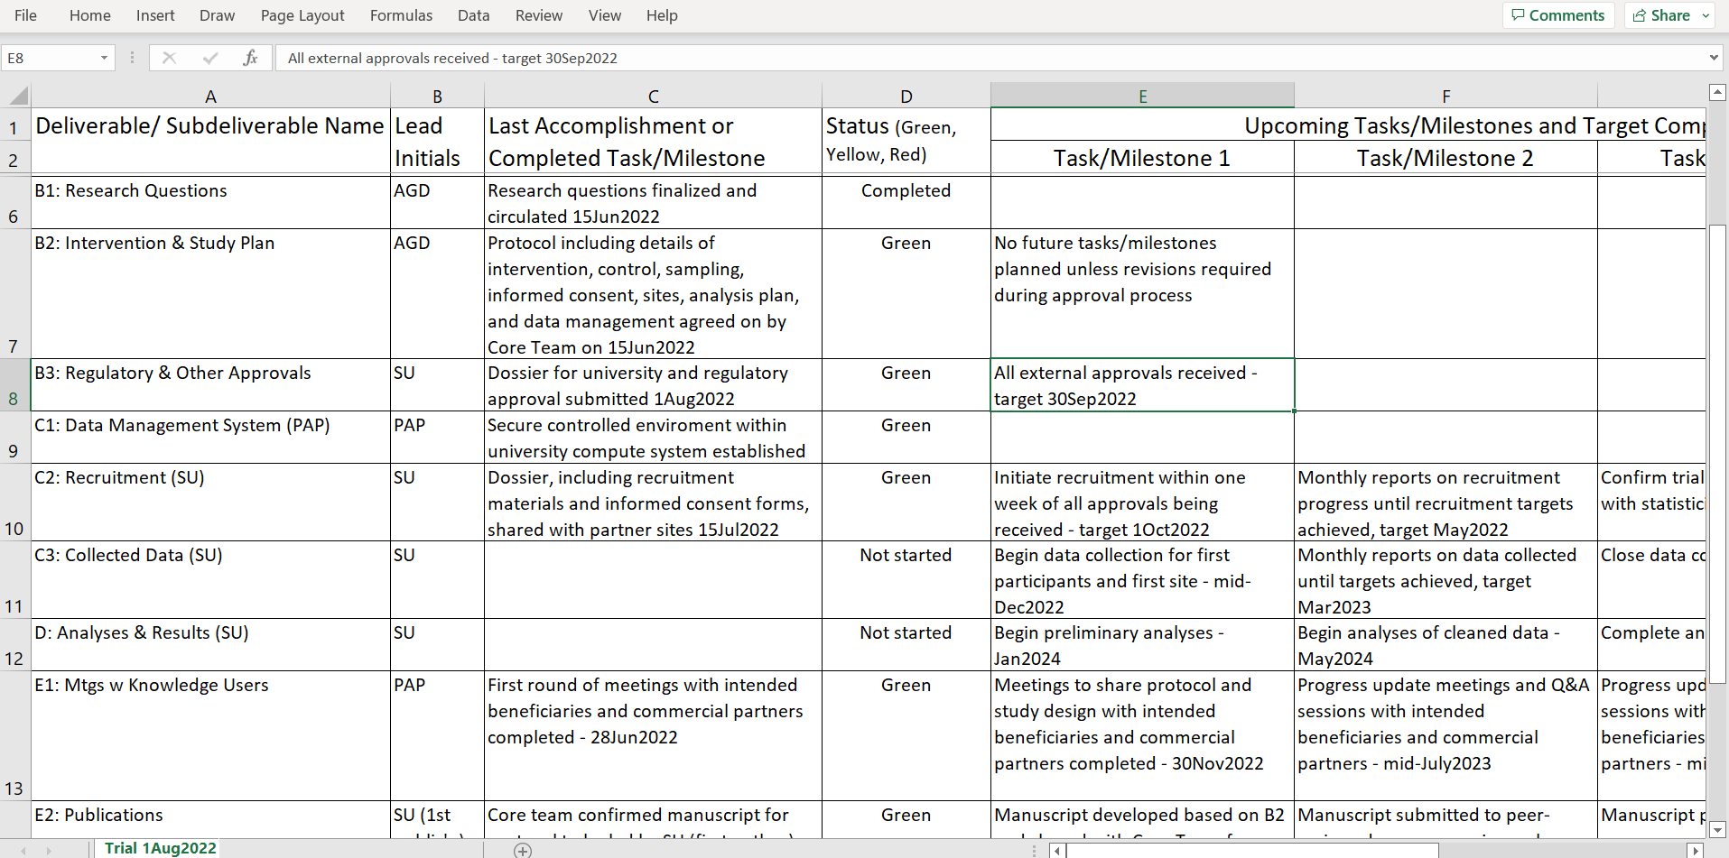
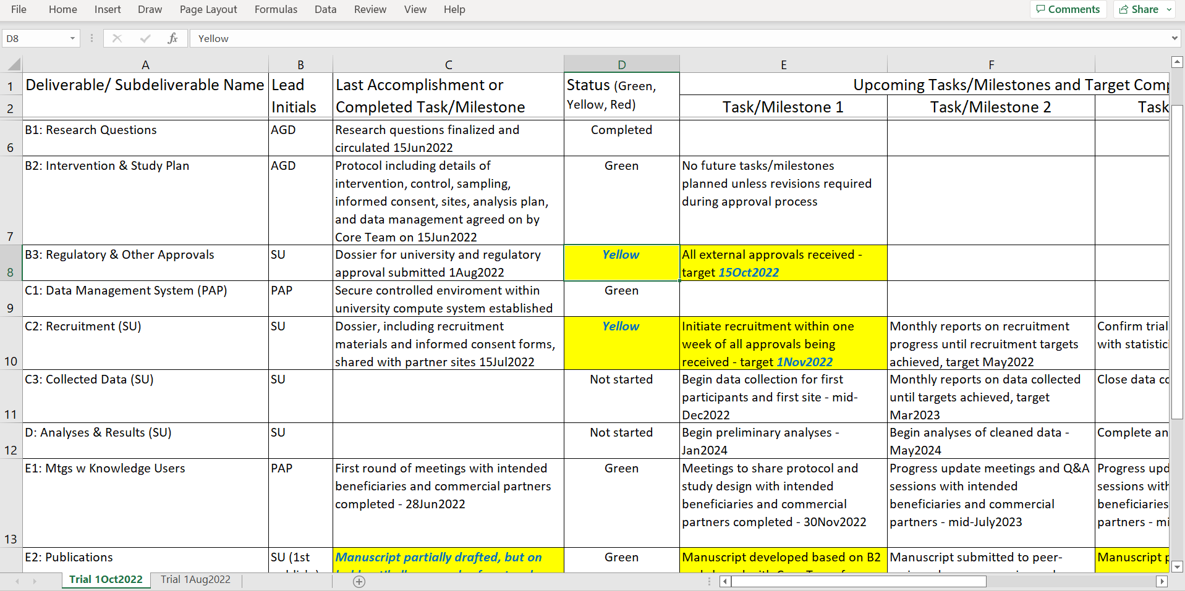
The Tracking Sheet
Demonstration

Slide 48
Benefits of the Tracking Sheet
Organizes tasks, activities, and milestones as streams of work under specific deliverables
Eliminates the need for other documents, e.g., no detailed minutes, no lists of action items
In this way, it minimizes time required for project management/administration to a few hours per Tracking Sheet update ~ monthly, bimonthly, or quarterly
Decreases risk by allowing team to monitor work between major milestones
Microsoft Excel format is easily updated and customized and can be populated as shared online document
Worksheets within the Microsoft Excel file provide a record of changes over time that can be used to support better planning and continuous quality improvement
Provides raw information for other documents including status reports, FYI accomplishments at meetings, and reports to funders

Slide 49
Bringing it all Together

Slide 50
Integrating Deliverable-Based Tools and Processes into Your Work
Your organization or funder may have certain required documents or templates
Charter, Statement of Work, standardized project reporting, etc.
Regardless of the details of those templates, there is likely room to incorporate the mindset of “DEFINE the DELIVER” somehow/somewhere by:
Defining the main deliverables of the project
Identifying who is responsible for leading the deliverables (possibly other roles too with a RACI)
Establishing a high-level schedule to guide when and how the deliverables will come together
Using a simple tool (like the Tracking Sheet) to monitor progress during implementation and drive the near-term activities that are required to produce the deliverables and achieve the objectives of the project

Slide 51
20,000 Foot View of Planning Tools
Incredibly Useful
WBS (with deliverable leads identified by the time you are in implementation)
Deliverable-based Gantt chart
Tracking Sheet
Usually Worth Adding
RACI
Deliverable-based budget with break down by funder categories
Status updates
Risk management plan
Helpful in Most Cases
Terms of Reference (TORs) for committees and governance bodies (including documented decision-making authorities/processes)
Stakeholder engagement plan and related documents (e.g., policy/practice briefs)
Communications (beyond status updates and regular review of risks, e.g., meeting agendas)

Slide 52
If You Want More Light-touch Project Management Tools and Capacity Building
Register for the Governance & Risk Management Webinar hosted by CRIS on January 20, 2023
Subscribe to or follow Centre for Research & Innovation Support (CRIS) to learn about additional project management training and capacity building opportunities
Stay tuned for Academic Research Project Management & Leadership: A Handbook for Everyone, to be published by Paprica with U of T press in spring 2023

Slide 53
Recap: Webinar Learning Objectives
By the end of the webinar, participants will be able to:
Understand how tailored project management tools can be applied to research projects;
Use a work breakdown structure (WBS) to visually present 100% of the scope of a project in terms of deliverables;
Use the deliverables of the WBS to create a Gantt chart schedule; and
Capture project progress information using a deliverable-based tracking sheet.

Slide 54
Q&A and Dialogue

